Slide 1

Greatest hits and misses of physical computing
Krzysztof Warmuz
Intro to Interactive Media
NYU Abu Dhabi

Slide 2
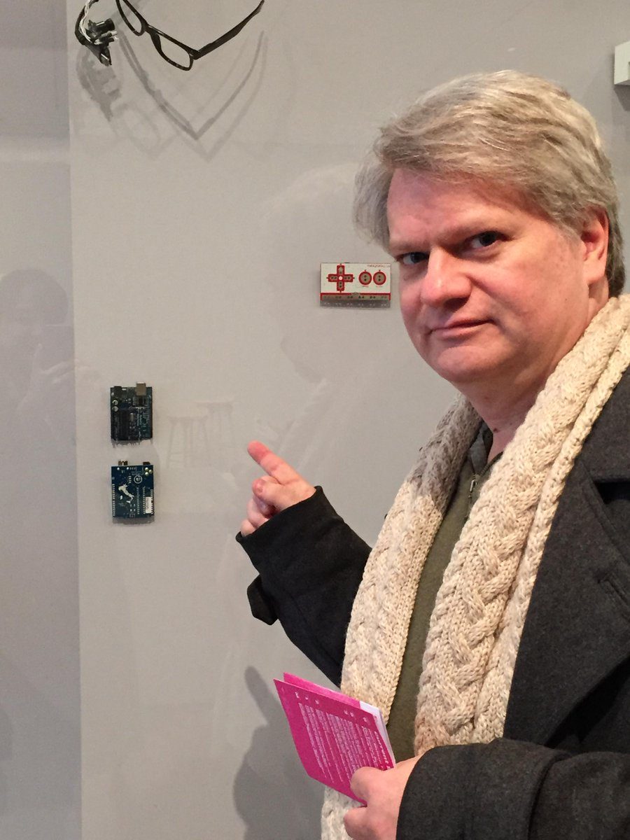
Tom Igoe
Tisch School of the Arts, NYU
physical computing and networking
Interactive Telecommunications Program

Slide 3
Physical computing
Interactive systems
That sense the world around them
And respond to it

Slide 4
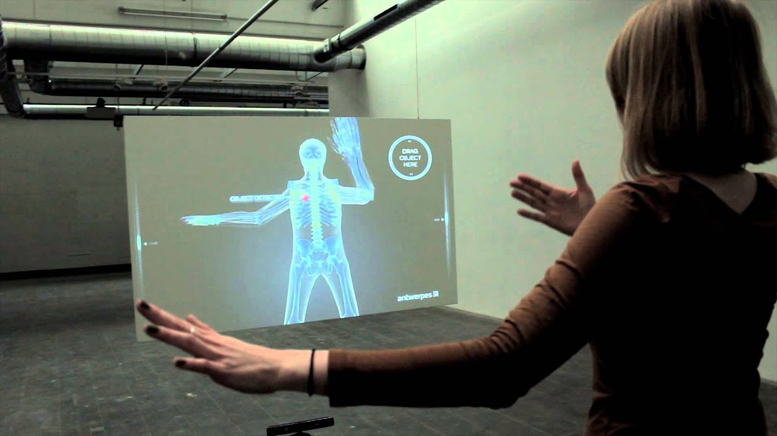
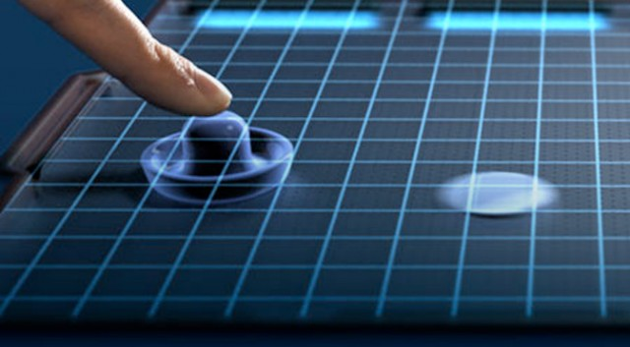
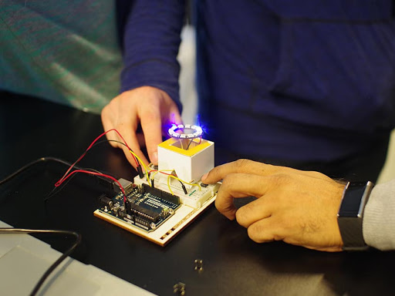
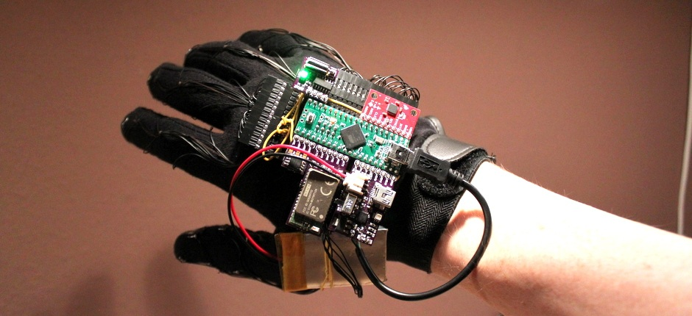
Examples
Gloves
Cameras
Touchscreens
Mechanical input

Slide 5
Discussion
The author makes a point that musical instruments are great physical interaction projects. Do you agree? Why?
What is the balance between fun and usability in the physical computing?
To what extent should user be instructed about given device vs given freedom to explore?
What would you label as hits and misses of physical computing?

